Slide 1

TEEGALA KRISHNA REDDY ENGINEERING COLLEGE
(Approved By AICTE , Affiliated To JNTUH, Accredited By NBA And NAAC)
DEPARTMENT OF COMPUTER SCIENCE & ENGINEERING
HEAD OF THE DEPARTMENT:
Dr. CH. V. PHANI KRISHNA
PROFESSOR
PROJECT CO-ORDINATOR:
A. MOUNIKA
ASSISTANT PROFESSOR

Slide 2
AI-Powered Automated Attendance System
SUPERVISOR:
MRS.P.SWETHA
ASSISTANT PROFESSOR
TEAM MEMBERS:
M.NITHISH KUMAR-23R91A05L6
P.RAHUL-23R91A05P1
P.HARSHITHA-23R91A05Q2
R.CHARAN KUMAR-23R91A05R2

Slide 3
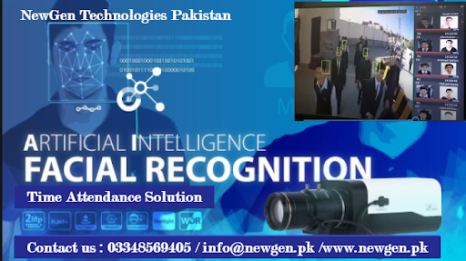
CONTENTS:
ABSTRACT
EXISTING SYSTEM
PROPOSED SYSTEM

Slide 4
ABSTRACT:
In the evolving landscape of digital education, efficient attendance management remains a critical challenge. Traditional attendance systems, often relying on manual roll calls or basic electronic methods, suffer from inefficiencies, inaccuracies, and vulnerabilities to misuse such as proxy attendance. As educational institutions grow larger and more complex, there is an increasing need for automated, reliable, and secure attendance solutions. An effective system should minimize manual intervention while ensuring accuracy, real-time monitoring, and ease of data management. The proposed AI-Powered Automated Attendance System leverages CCTV cameras combined with advanced computer vision and deep learning techniques to automatically detect and recognize student faces in real time. This approach eliminates manual errors, reduces administrative workload, and prevents fraudulent attendance practices. By integrating intelligent face recognition algorithms with a centralized database, the system offers seamless attendance tracking, efficient data storage, and easy accessibility for faculty and administrators. As educational environments continue to modernize, this solution is well-equipped to meet growing demands, providing a scalable, secure, and forward-thinking attendance management system.

Slide 5
EXISTING SYSTEM:
The existing attendance system mainly relies on manual roll calls, paper-based registers, or basic electronic systems such as RFID cards and biometric scanners. These systems require physical interaction, causing delays and crowding during attendance marking. Proxy attendance remains a common issue due to card sharing or fingerprint manipulation. Additionally, these systems lack real-time monitoring and automated verification, making it difficult to detect fraudulent attendance. Managing attendance records manually or with limited automation is cumbersome, especially for large classrooms, resulting in inefficiency and errors
Drawbacks:
Manual Process: Requires teachers to call out names or students to sign registers, consuming valuable class time.
Physical Interaction: Students must use cards or biometric devices, causing delays and queues.
Proxy Attendance: Card sharing and fingerprint spoofing allow dishonest attendance marking.
No Real-Time Monitoring: Lack of continuous verification and supervision during attendance.
Inefficient Record Management: Manual or semi-automated record keeping is error-prone and hard to analyze.
Low Scalability: Difficult to implement effectively in large classrooms or institutions.

Slide 6
PROPOSED SYSTEM:
The proposed system introduces an AI-powered automated attendance solution using CCTV cameras and facial recognition technology. Classroom cameras capture real-time video, and AI algorithms detect and recognize student faces automatically. Attendance is marked instantly and stored securely in a centralized digital database, eliminating manual intervention. The system prevents proxy attendance by verifying identities continuously, enhances accuracy, and allows easy access to attendance records and reports for faculty and administrators. Built with Python and OpenCV for face recognition, Flask/Django backend, React.js frontend, and MySQL/MongoDB for data storage, the system is scalable, efficient, and secure.
Advantages:
Automated Attendance: Eliminates manual roll calls, saving classroom time.
Contactless Identification: Uses facial recognition without physical interaction.
Proxy Prevention: Detects and prevents proxy attendance in real time.
Continuous Monitoring: Ensures students remain present during sessions.
Accurate Record Keeping: Automatically updates and manages attendance data securely.
Easy Access & Reporting: Provides intuitive interfaces for faculty and admins to review attendance.
Scalable & Secure: Suitable for small to large educational institutions with strong data protection.

Slide 7
THANK YOU

